Slide 1

Web Programming II
420-4W6-AB
Instructor: Talib Hussain
Week 1: Exercise 0.2 (Node Basics)
Notes:
Image from: https://www.evolveincorporation.com/web-development

Slide 2
Objectives
Explain what NodeJS is and why its useful.
Compare and contrast client-side JavaScript using a browser versus server-side JavaScript using Node.
Explain the difference between blocking (synchronous) code and non-blocking (asynchronous) code.
Write both blocking and non-blocking code.

Slide 3
Node.js: Runtime Environment
Node is a Javascript runtime environment
Also referred to as a framework sometimes
Before Node, the only place JS could run was in a web browser runtime environment.
JS was used only to add interaction to web pages like customizing what happens when a user clicks on a button or dynamically manipulating the DOM (Document Object Model).
With Node, we can create applications that run directly on our machines rather than in a web browser.
Node is an alternative runtime that can run JS such that we can do things like access the file system of our computer or talk to databases.
This means that we can now use JS to program both the front-end (client) and back-end (server) of our web applications.

Slide 4
One language to rule them all?
Since Node is just JS at the end of the day, this means that you can use one language for the whole stack (front and back end) which reduces the need to know/maintain multiple languages/technologies.
Javascript (in 2021) is the most commonly used programming language.
https://insights.stackoverflow.com/survey/2021#section-most-popular-technologies-programming-scripting-and-markup-languages
Node.js is (in 2020) the most popular “miscellaneous technology”
https://insights.stackoverflow.com/survey/2020#technology-other-frameworks-libraries-and-tools
Node jobs are highly in demand in the web sector.
https://ca.indeed.com/jobs?q=node.js&l=Montr%C3%A9al%2C+QC

Slide 5
Client-Side vs Server-Side
First we'll play around with JavaScript in the browser to establish a baseline.
i.e., Client-Side
This should be very familiar to you already coming from Web Programming I from last semester.
After that, we'll see how JS is different when running it with Node instead of a browser.
To setup:
Create a folder called Web-II/Exercises/0.2-Node-Basics
Start Visual Studio and reload your Web2Exercise0 project. You can minimize it for now.
🔨

Slide 6
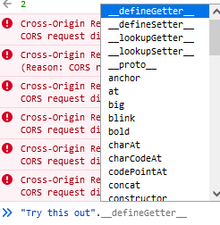
Client-Side Javascript
Open your web browser of choice. Preferably 🌈 Chrome or 🦊 Firefox.
Open the developer tools by hitting CTRL + SHIFT + I and make sure you're on the console tab.
Type a mathematical expression like 1 + 1 into the console and hit enter. You should see 2 as the output.
Type any string and then . like you want to call a function. You should see a list appear of all the functions you can call on a string. There are lots!
Choose the .toUpperCase() method and execute the statement. You should see the string in all caps as the output.

Slide 7
Try It! Manipulating Page Content
Now let's try something a bit more fun!
Go to Google's homepage, right-click the logo, and click on inspect element. In the DOM that appears in the dev tools, find the id attribute that the <img> tag is using to display the Google logo. Take note of that id value.
In another tab, look up any (appropriate) image you think would be funny to display on the Google page and copy the URL to the image. Make sure the URL ends in a valid image file extension like .jpg, .png, etc.
Back to the Google tab, in the dev tools console, type:
document.getElementById('id from step 6').srcset = '';
document.getElementById('id from step 6').src = 'image URL from step 7’;
And you should see your image replace the Google logo!

Slide 8
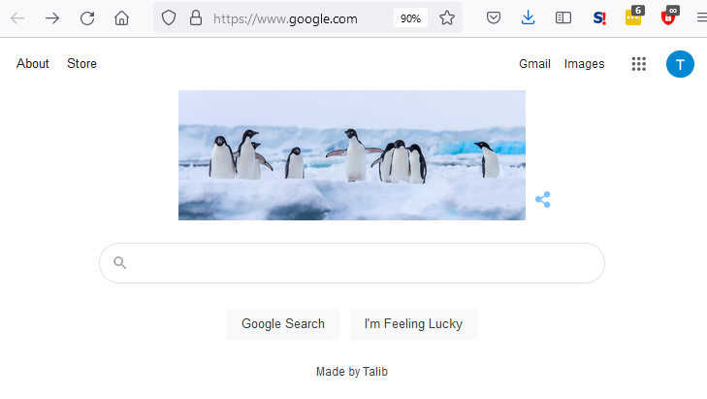
Try It! Manipulating Page Content cont.
Right-click on the text next to the Google search button that says "Google offered in: Français" and note the ID of that element.
In the dev tools console, change the text of the element to read Made by <Your Name> using JavaScript.
It will be similar to how you changed the .src attribute on the <img> element from step 8, but you'll have to use the .innerHTML property this time to change the text.
Take a screenshot of the page with your new image and text and save it inside the Web-II/Exercises/02-Node-Basics folder
It should resemble something like this:

Slide 9
Server-Side Javascript (Node)
Switch over to the terminal in your Visual Studio window (View->Terminal, or right-click on project name in solution explorer and select open in terminal)
Type node and hit enter.
You should see that your terminal's prompt has changed to >.
This means that you're inside of a Node REPL which stands for read evaluate print loop. We can use this REPL environment just like we used the browser dev tools console in the previous section of this exercise.
As before, type a mathematical expression like 1 + 1 into the console and hit enter. You should see 2 as the output just like when you did this in the browser.
As before, type any string and then execute the .toUpperCase() method. You should see the string in all caps as the output.

Slide 10
Server-Side cont.
Maybe by now you're thinking, "Well, if everything is the same here (in the terminal) as it is in the browser, then what's the big deal?". Great question!
The next thing we tried in the browser was accessing the document object. Let's try doing that now. What happens if you type document into the REPL Node environment?
> document
Uncaught ReferenceError: document is not defined
Why doesn't document work here? Turns out, document is not part of JavaScript. It's actually a part of the web browser. The browser gives JS access to the DOM by passing it a document object it can use. Since there's no browser when using Node, that means there is no document object!

Slide 11
Server-Side cont.
Now type process into the REPL and hit enter.
What we're seeing here is several methods and properties that the Node runtime is giving to JS.
With this process object, we can do many things that we could not do in the browser. To prove it, try typing process in the browser dev tools console. You'll see it will come up as undefined.
One of the methods we can call right now on the process object is called exit(). Type process.exit()and you'll see that we're now back to the regular terminal prompt.

Slide 12
Server-Side cont
Type node to reenter the REPL
Now, type the following line. We’re creating an event handler to do something when we exit.
process.on('exit', (code) => {
console.log('Process exit event with code ‘ + code);
});
Now, type process.exit() again. See the new message?
Take a screenshot of the console with the lines you just typed and the output message. Save it to the Web-II/Exercises 0.2 folder

Slide 13
Node.js: Key Capabilities
Asynchronous programming
Single-threaded, non-blocking, asynchronous
What Can Node.js Do?
Generate dynamic page content
Create, open, read, write, delete, and close files on the server
Collect form data
Add, delete, modify data in your database
The main idea of Node.js: use non-blocking, event-driven I/O to remain lightweight and efficient in the face of data-intensive real-time applications that run across distributed devices.

Slide 14
Blocking vs. Non-Blocking Code
Blocking code means that you have to wait for the first operation to finish before the second operation can start.
With Node, it is very easy to write code that is non-blocking. This means that you can perform several operations at a time without having to wait for one to finish before executing another.
In your IDE, create two new files at the top level (same as server.js) called sync.js and async.js.

Slide 15
Sync
Inside of sync.js write a function called getUserSync(id). This function will wait 2 seconds and return an object.
This function will take an integer as input.
In the body of the function, declare a variable called timeToStop and set its value to Date.now() + 2000. This value represents a time that is 2 seconds in the future.
Write a while loop that has Date.now() < timeToStop as the condition. Leave the body of the loop empty {}. As you can probably guess, this loop will act as a delay mechanism.
At the end of the function, return an object that has one property. This property should have a name of userId and a value of id.
After the getUserSync function is complete, call it and pass in 1 as the id. Print the result with console.log().
Call getUserSync again and pass in 2. Print the result.
Declare a variable called sum and assign it the expression 1 + 2, then print sum.
Save (Ctrl-S) and then run the program by executing node sync.js in the terminal. Make sure you're in the right directory! What you should see is:
The program waiting 2 seconds then printing { userId: 1 }
Waiting another 2 seconds then printing { userId: 2 }
Printing 3

Slide 16
Async
Inside of async.js, write a function called getUserAsync(id, theCallback). This function will asynchronously invoke the callback function we pass into it.
If you need a refresher on callback functions, click https://www.youtube.com/watch?v=pTbSfCT42_M .
In the body of getUserAsync, call the setTimeout() method and pass into it 2 parameters:
A callback function that invokes theCallback we originally passed into getUserAsync(). When invoking theCallback, use the () => {} notation and pass in the id as a parameter like this: () => { theCallback(id); }
The integer 2000 which represents 2 seconds.
The purpose of setTimeout is to execute code after a specified period of time. What is "special" about setTimeout is that it is asynchronous. This means that your program will continue to execute while setTimeout waits for time to pass on its own.
Call getUserAsync and pass in 1 for the first parameter. The second parameter will be the callback function that we want getUserAsync to invoke.
You can either write this callback function externally and pass it in by name:
getUserAsync(1, namedCallback);
or you can pass it anonymously in the parameter list:
getUserAsync(1, () => { /* Function body goes here. */ });
This callback function should take one parameter: id.
The body of the callback function should call console.log, which should print an object. This object should have one property whose key is userId and value is id.

Slide 17
Async cont.
Call getUserAsync again and pass in 2 for the first parameter, and the same callback as the second parameter
Declare a variable called sum and assign it the expression 1 + 2, then print sum.
Run the program by executing node async.js in the terminal. Make sure you're in the right directory!
What you should see is:
The program will print 2 right away
It will wait 2 seconds and then print { userId: 1 } and { userId: 2 } simultaneously.

Slide 18
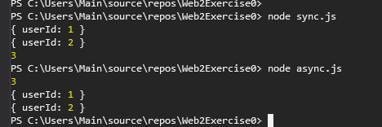
Wrap-Up
Take a screenshot of the terminal containing the output from running both scripts and save it in your Web-II/Exercises 0.2 folder you created in the 🔨 Setup section of this exercise.
Copy your sync.js and async.js to the folder too.
Submit the contents of your folder to the Exercise 0.2 drop box on Moodle

Slide 19
Wrap-Up
Can you see the difference between blocking/synchronous code and non-blocking/asynchronous code?
The blocking example had to wait for each step of the program to finish before executing the next line.
The non-blocking example was able to start executing 2 calls of a function while printing the result of 1 + 2 at the same time (i.e., while waiting!) Cool 😎
Can you see the distinction between JS in the browser and JS in Node a little bit better?
The core of the JavaScript language stays the same between the two.
What changes is the objects that the runtime environment gives to JavaScript to work with.

